Slide 1
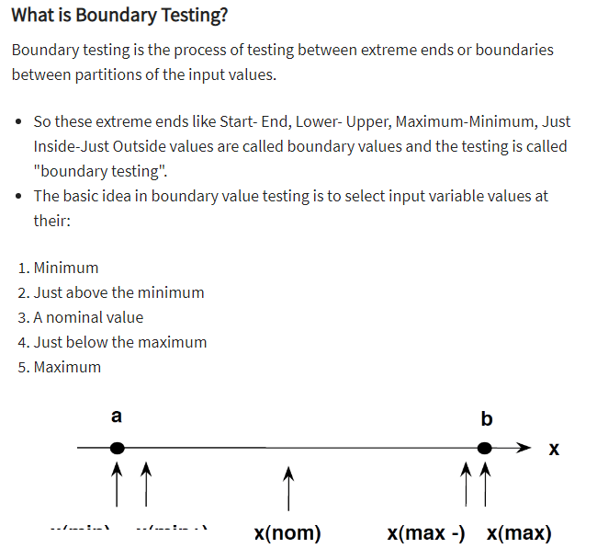

Slide 2
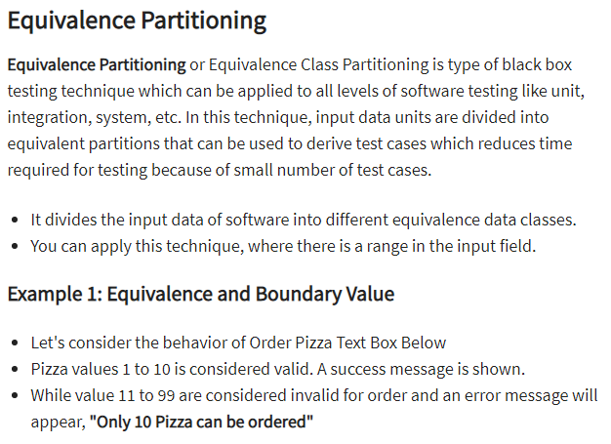

Slide 3
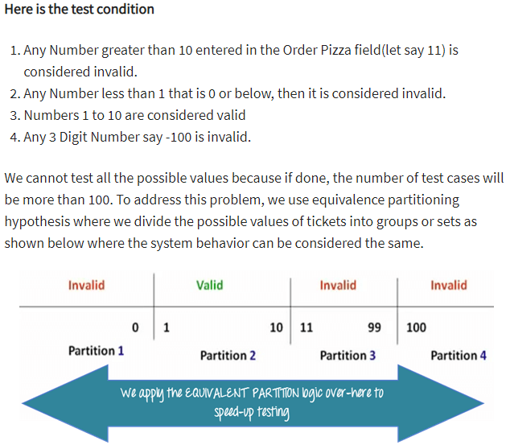

Slide 4
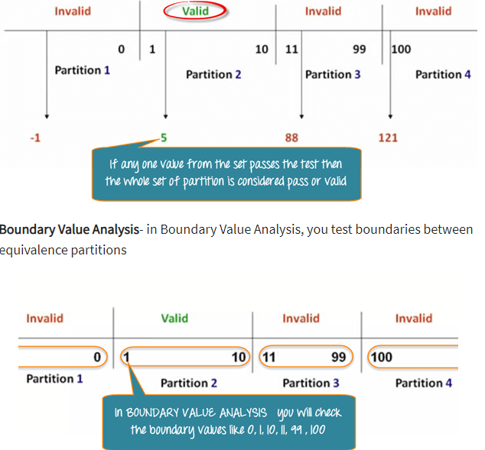

Slide 5
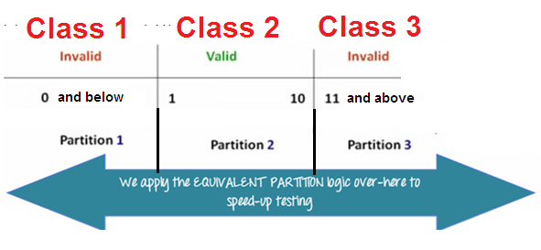

Slide 6
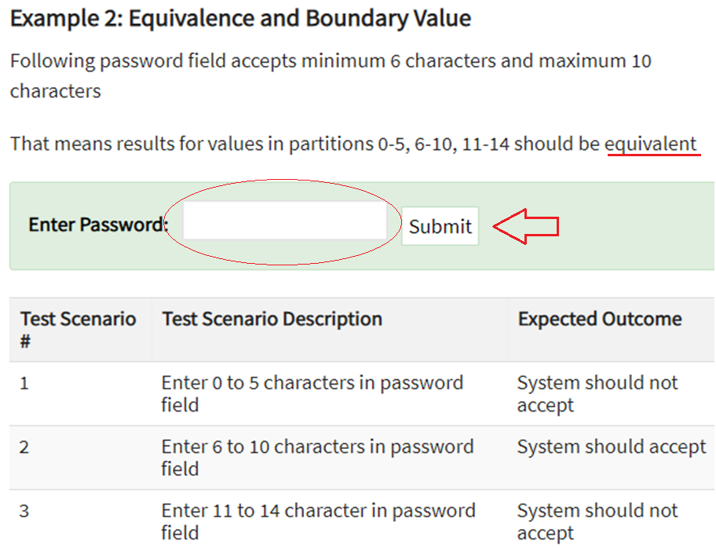

Slide 7
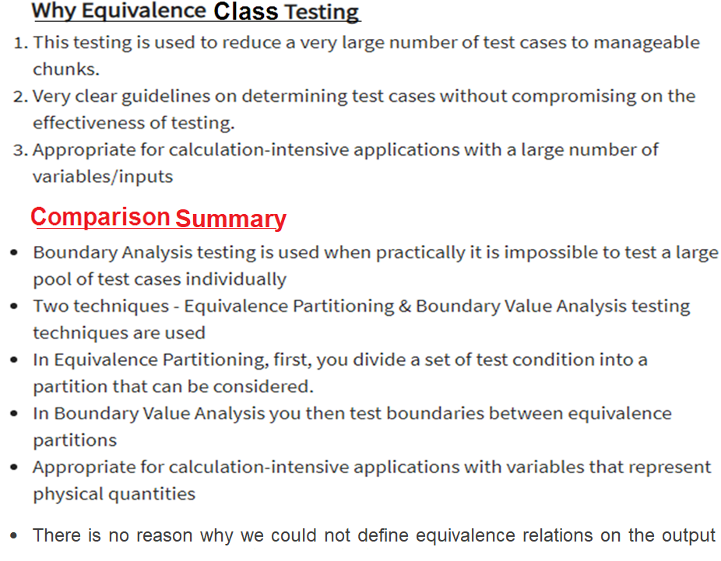

Slide 8
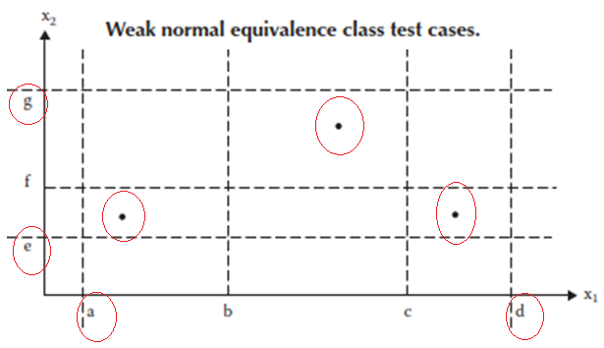
Weak Normal Equivalence Class Testing
Weak normal equivalence class testing is accomplished by using one variable from each equivalence class (interval) in a test case
One test case from one class and for example of total three classes ‘weak normal equivalence class’ testing has 3 test cases shown with dots in Figure below.
The test case in the lower left rectangle corresponds to a value of X1 in the class [a, b) and to a value of X2 in the class [e, f ) and so on

Slide 9
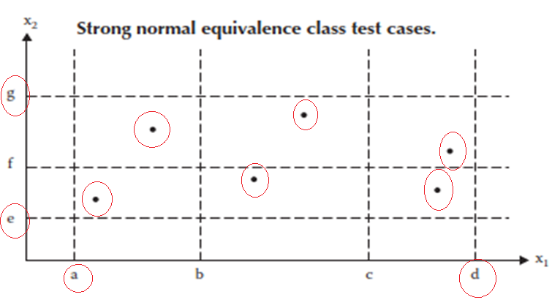
STRONG Normal Equivalence Class Testing
Strong equivalence class testing is based on the multiple fault assumption
We need test cases from each element of the Cartesian product of the equivalence classes, as shown in Figure.
The Cartesian product guarantees that we have a notion of “completeness” in two senses: we cover all the equivalence classes, and we have one of each possible combination of inputs.

Slide 10
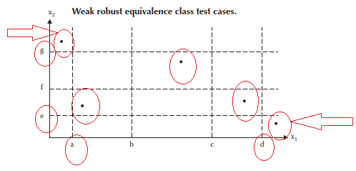
Weak robust Equivalence Class Testing
How something can be both weak and robust?
The robust part comes from consideration of invalid values, and the weak part refers to the single fault assumption.
The process of weak robust equivalence class testing is a simple extension of weak normal equivalence class testing + classes that exceed the bounds(lower, upper)
Then pick one test case from each class , such that robust classes also represented as shown in Figure below.

Slide 11
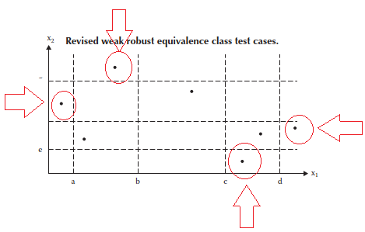
Pure Weak robust Equivalence Class Testing
There is a potential problem with the test cases in the upper left and lower right corners, which represents values from two invalid equivalence classes.
Failure of either of these could be due to the interaction of two variables / multiple faults !!!.
But , Weak Robust Equivalence Class Testing works on single fault assumption. Correcting earlier figure the new test cases modified as follows,

Slide 12
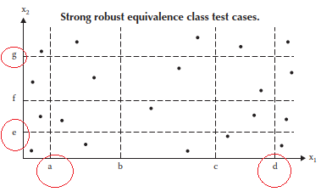
Strong robust Equivalence Class Testing
As usual, the word robust part comes from consideration of invalid values.
The strong part refers to the multiple fault assumption.
We obtain test cases from each element of the Cartesian product in all the equivalence classes,
Both valid and invalid, as shown in Figure below., which consists of most redundant test cases.

Slide 13
Equivalence Class test Cases
the triangle problem
In this problem statement, we have four possible outputs- i. Not a Triangle
ii. Scalene
iii. Isosceles
iv. Equilateral
We can use these to identify equivalence classes resulting as the outputs shown as follows,
i. R1 = {<a, b, c>: the triangle with sides a, b, and c is equilateral}
ii. R2 = {<a, b, c>: the triangle with sides a, b, and c is isosceles}
iii. R3 = {<a, b, c>: the triangle with sides a, b, and c is scalene}
iv. R4 = {<a, b, c>: sides a, b, and c do not form a triangle}
Taking above principle into account we can form all the 4-equivalence class test cases for Triangle Problem as shown in the tables on the next slide

Slide 14
Tringle Problem: Equivalence Class Test Cases
The 3 sides of the Triangle problem can assume any value between the range 1-10. While devising ‘Test Cases’ we have to think each variable is independent.
Then It can be shown with minimum 3 equivalence classes, apart from the classes on both side of the values exceeding the bounds.
D1 = {<a, b, c>: a = b = c}
D2 = {<a, b, c>: a = b, a ≠ c}
D3 = {<a, b, c>: a = c, a ≠ b}
D4 = {<a, b, c>: b = c, a ≠ b}
D5 = {<a, b, c>: a ≠ b, a ≠ c, b ≠ c}

Slide 15
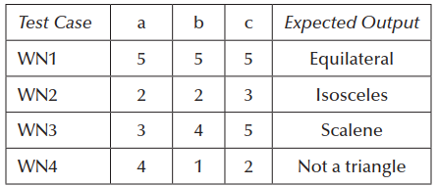
Weak Normal Equivalence Class test cases

Slide 16
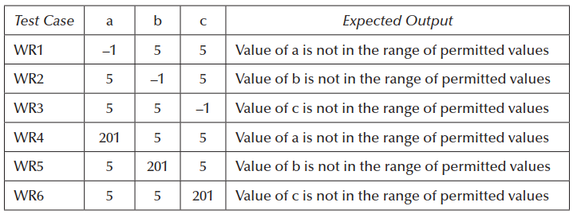
Weak Robust Equivalence Class test cases

Slide 17
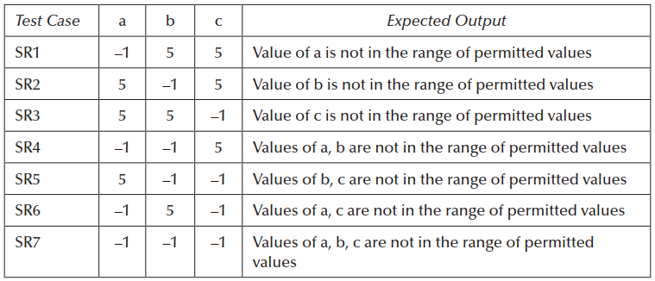
Strong Robust Equivalence Class test cases

Slide 18
Equivalence Class test NextDate - Function
For the NextDate Function we have the following assumptions:
M1 = {month: 1 ≤ month ≤ 12}
D1 = {day: 1 ≤ day ≤ 31}
Y1 = {year: 1812 ≤ year ≤ 2012}
The invalid equivalence classes are:
M2 = {month: month < 1}
M3 = {month: month > 12}
D2 = {day: day < 1}
D3 = {day: day > 31}
Y2 = {year: year < 1812}
Y3 = {year: year > 2012}

Slide 19

Weak Normal Equivalence Class test cases
Because the number of valid classes equals the number of independent variables, only one weak normal equivalence class test case occurs
Which is identical to the strong normal equivalence class test case as shown in table:

Slide 20
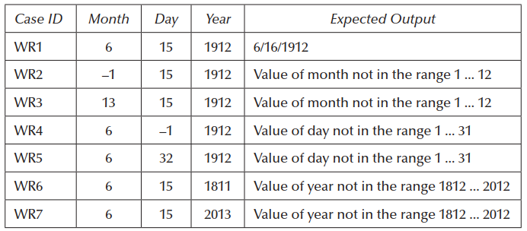
Weak Robust Equivalence Class test cases

Slide 21
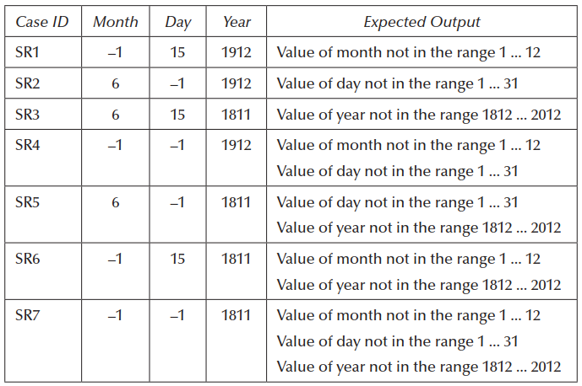
Strong Robust Equivalence Class test cases

Slide 22
Usefulness Analysis :
If we more carefully choose the equivalence relation, the resulting equivalence classes will be more useful.
The gist of the equivalence relation is that elements in a class are “treated the same way”
We next reduce the granularity by focusing on more specific treatment.
What must be done to an input date? If it is not the last day of a month, the NextDate function will simply increment the day value.
At the end of a month, the next day is 1 and the month is incremented.
At the end of a year, both the day and the month are reset to 1, and the year is incremented.
Finally, the problem of leap year makes determining the last day of a month interesting.

Slide 23
With all this in mind, we might postulate the following equivalence classes:
M1 = {month: month has 30 days}
M2 = {month: month has 31 days}
M3 = {month: month is February}
D1 = {day: 1 ≤ day ≤ 28}
D2 = {day: day = 29}
D3 = {day: day = 30}
D4 = {day: day = 31}
Y1 = {year: year = 2000}
Y2 = {year: year is a non-century leap year}
Y3 = {year: year is a common year}

Slide 24
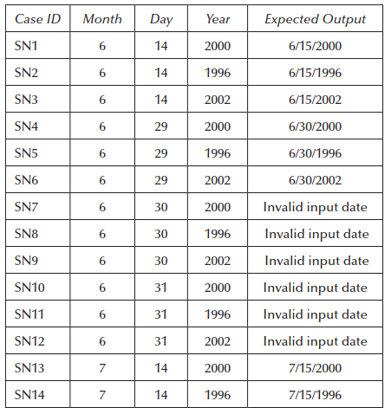
Results of wrong assumption:

